Slide 1

Columbia Asia
Hospital
BY :- SANDESH MORE

Slide 2

01 INTRODUCTION
02
03
04
PROBLEM STATEMENT
OVERVIEW OF COLUMBIA
ASIA HOSPITAL
ANALTICAL APPROACH AND
TOOLS
05 DASHBOARDS

Slide 3

INTRODUCTION
q Columbia Asia Hospital is a chain of hospitals headquartered in Malaysia, with a network of
hospitals across Asia, including countries like India, Indonesia, Vietnam, and others. The hospitals
are known for their patient-centric approach, advanced medical technology, and quality healthcare
services.
q Columbia Asia hospitals typically offer a wide range of medical services, including specialties such
as cardiology, oncology, orthopedics, neurology, and more. They focus on providing accessible and
affordable healthcare to their patients, often incorporating international standards and best
practices into their operations.
q Each Columbia Asia hospital is designed to be efficient, with streamlined processes and modern
facilities. They often emphasize a patient-friendly environment, aiming to provide comfort and
convenience to those seeking medical treatment.

Slide 4

PROBLEM STATEMENT
q You have been hired as a consultant data analyst by Columbia Asia Hospital. The Hospital is
looking for the key insights for the following objectives: Assess the hospital's revenue generation
q Insights about suitable departments for new hires
q Strategies and suggestions for patient discounts
q The healthcare industry continuously strives to understand patient demographics and their
healthcare utilization patterns to optimize services and improve patient outcomes.
q This presentation focuses on analyzing department referrals, physician billing patterns,
Satisfaction score and revenue generated for 2019 & 2020.

Slide 5

OVERVIEW OF COLUMBIA ASIA HOSPITAL
q A total of 9216 patients have been attended to across the hospital premises, signifying a significant
reliance placed on our healthcare services.
q An impressive revenue of $509.31 million has been generated, reflecting the trust and investment made
by our patients in their well-being.
q The hospital is staffed with 22 doctors, ready to address a myriad of medical concerns with their
expertise.
q Seven distinct departments are operational within the hospital, catering to various medical
requirements.
q Patient satisfaction is indicated by an average score of 5.47, highlighting the quality of care provided.
q The General Practice department emerges as the most frequented area within the hospital premises.
q Within our diverse patient community, gender and race are seamlessly integrated, ensuring equitable
access to healthcare services for all.

Slide 6

OVERVIEW OF THE DATASET
q There are mainly two datasets provided by the newton school which are
Doctors_patients_data dataset and hospital er dataset
q Both the dataset are in structure and in standard format ,but there are some
inconsistencies in hospital er dataset, inconsistencies like there are some null
values.
q DOCTORS_PATIENTS_DATA DATASETS CONTAINS COLUMNS NAMED AS:-
patient_id ,department_referral ,Doctor Name ,Appointment Fees ,Total Bill,Doctor ID
q HOSPITAL ER DATASETS CONTAINS COLUMNS NAMED AS:-
date ,patient_id ,patient_gender, patient_age, patient_sat_score, patient_first_inital,
patient_last_name, patient_race, patient_admin_flag, patient_waittime,
department_referral

Slide 7

ANALTICAL APPROACH AND TOOLS
q Data Cleanup: Used Power Query Editor functions to assess column integrity, health, and
identify any missing values.
q Data Enhancement: Augmented the dataset by incorporating additional variables through
various DAX functions, cross-referencing with external data sources for validation.
q Descriptive Analytics: Introduced new measures to summarize important metrics and detect
distribution trends among different departments and patient categories.
q Data Visualization: Developed dynamic charts and reports to visually represent the data,
facilitating interactive exploration and analysis.

Slide 8

ACCESS THE HOSPITAL REVENUE GENERATION
q Total revenue generated is about $509.31m
q Total revenue generated can be obtained by subtracting the total appointment
Fees, considered as expenses, from the overall revenue generated, we arrive at a
Total profit of $503.96 million.
q This profit margin not only reflects the hospital's established reputation but also
serves as a significant motivator for both doctors and management to expand
and enhance their services further.

Slide 9
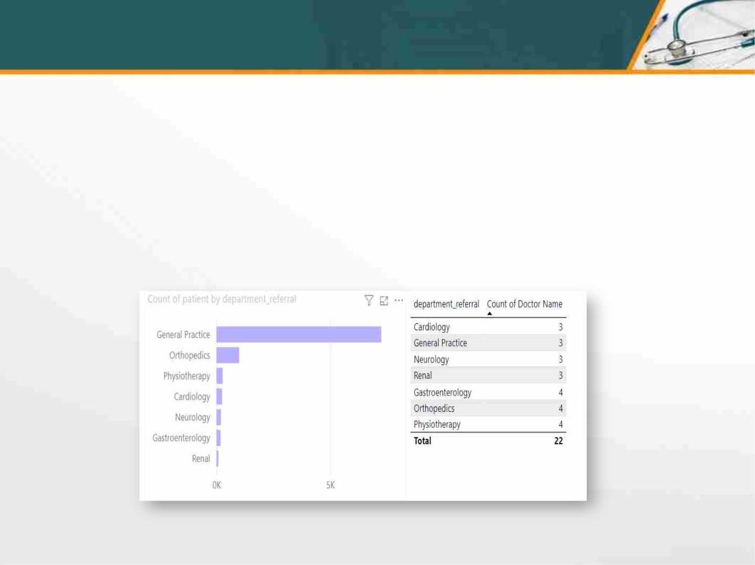
NEW DOCTORS HIRING
If the hospital has the budget to hire 2-3 new doctors so we must analysis which
department has highest count of patients visits and number of doctors assign to that
particular department.
By analysing the chart and table we can draw a conclusion that we must hire new doctors
for General Practice department because it has more number of patients and count of
doctors are also less. We can also tell the new hired doctors that they have to work in
Shifts(AM/PM)

Slide 10

PATIENTS DISCOUNTS STATERGIES
As we can notice that the hospital is in profit, which means patients have a strong
Trust on the hospital as well as on the doctors so to make this trust more strong
There are some statergies like.
Bulk Discounts: Offer discounts for patients
who purchase multiple appointments or
services in advance.
Referral Discounts: Encourage patients to
refer friends and family by offering them a
discount on their next visit for each successful
Referral.
Senior or Student Discounts: Provide discounted
rates for seniors or students.
Bundle Services: Offer discounts for patients who
bundle multiple services together.

Slide 11
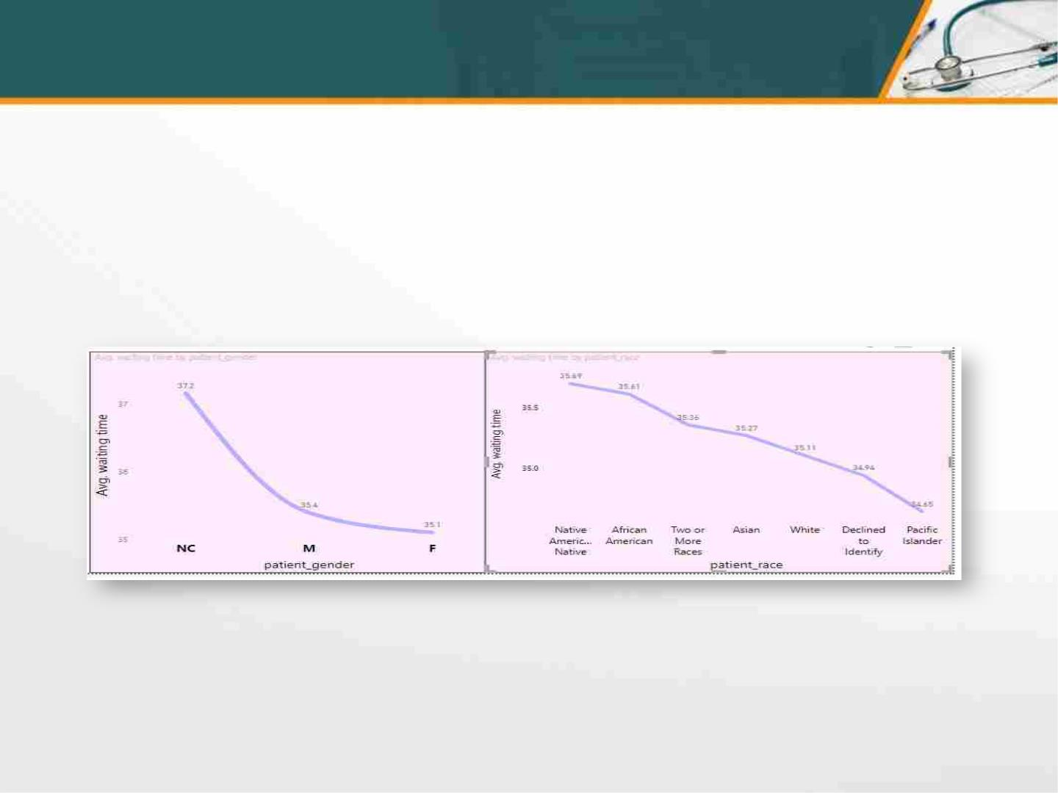
DISCRIMINATION BASED ON GENDER/RACE
Although the hospital is providing the best facility with excellents doctors staff
With high revenue generation which makes the hospital good and profitable but the
Hospital is lacking behind in doing the discrimination based on gender or race as the
Patients that visited the hospital is from different race and gender.
I made these statment based on the analysis i made from the below charts.
As we can see that the patients that do not want to disclose there gender have to
Wait for long time same as the native people like native american are also wait for
Long time.

Slide 12

APPROACHES
q Data Exploration: Begin by immersing yourself in the data model within Power BI. Take a deep dive
Into the tables and fields available, understanding their representations and relationships.
q Identification of Quantifiable Metrics: Focus on fields that deal with numerical values,
percentages, or rates. These metrics often form the foundation for objective questions that can be answered
through data analysis.
q Visualization for Insight: Utilize visualizations such as charts and graphs to uncover trends and
patterns hidden within the objective data. These visual cues often spark the formulation of concrete
questions.
q Recognition of Potential Subjectivity: While objective data takes precedence, keep an eye out
for areas where subjective analysis may offer valuable insights.
q Utilization of DAX Calculations: Leverage the power of DAX calculations in Power BI to create new
fields that derive insights from existing data.
q Inquisitive Approach: As you delve deeper into the data, adopt an inquisitive mindset, questioning the
"why" and "how" behind observed trends. These queries often lead to the discovery of objective questions that
can be addressed through thorough data analysis.

Slide 13

DASHBOARDS

Slide 14
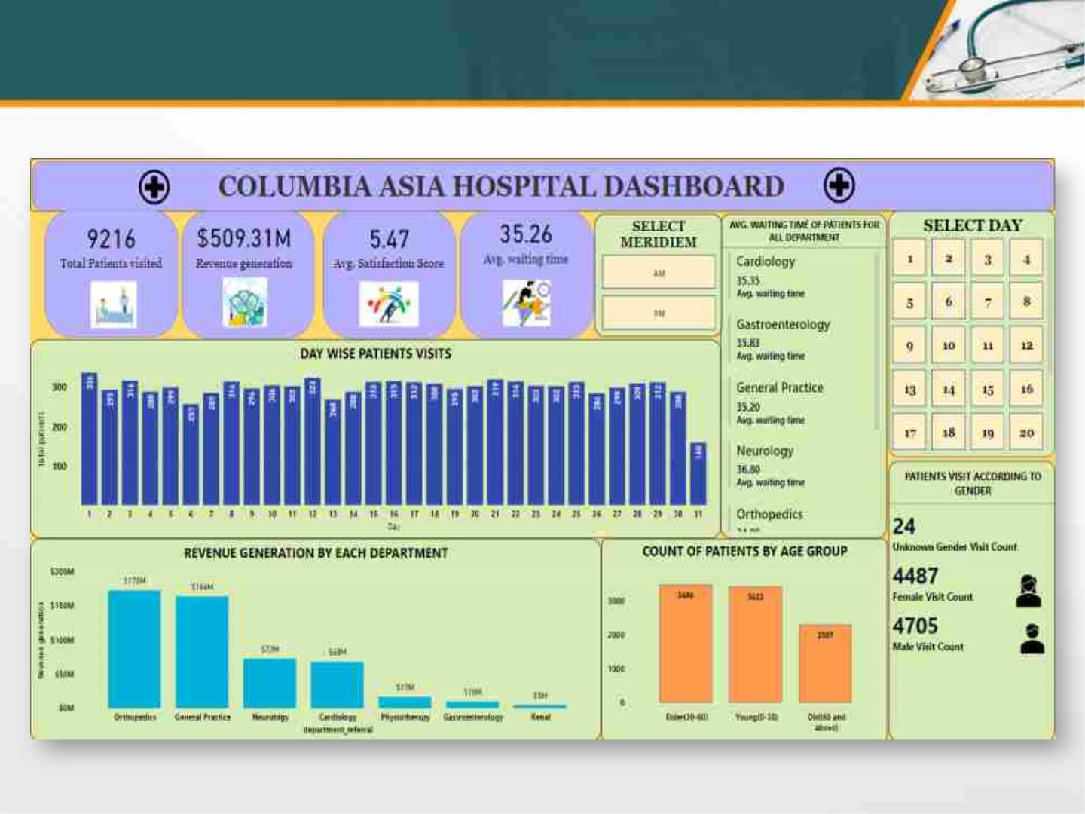
MAIN DASHBOARD

Slide 15
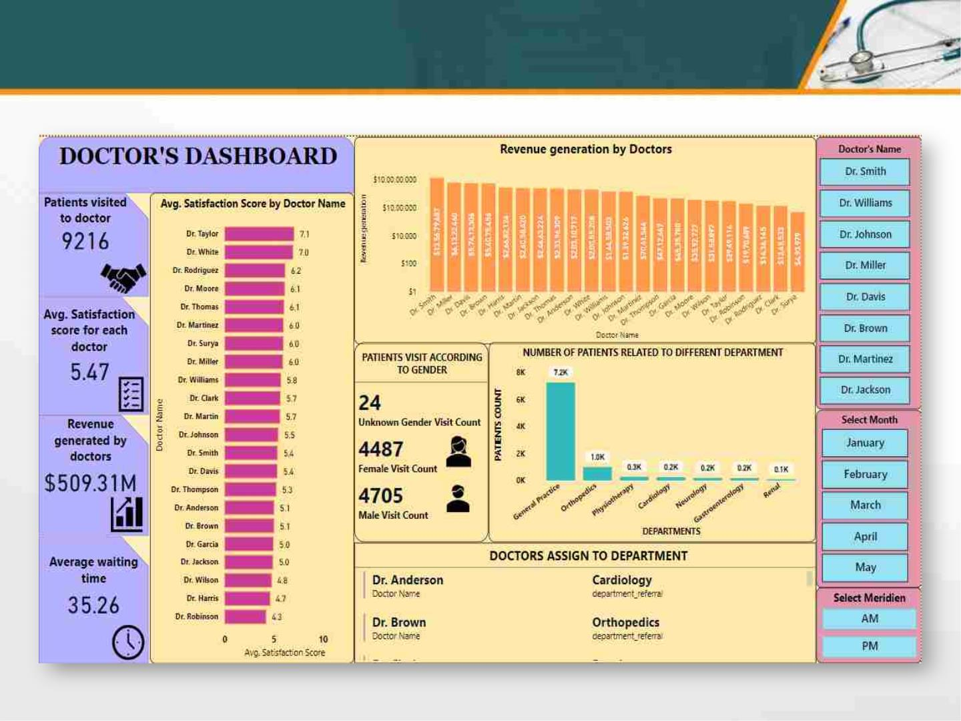
DOCTORS DASHBOARD

Slide 16
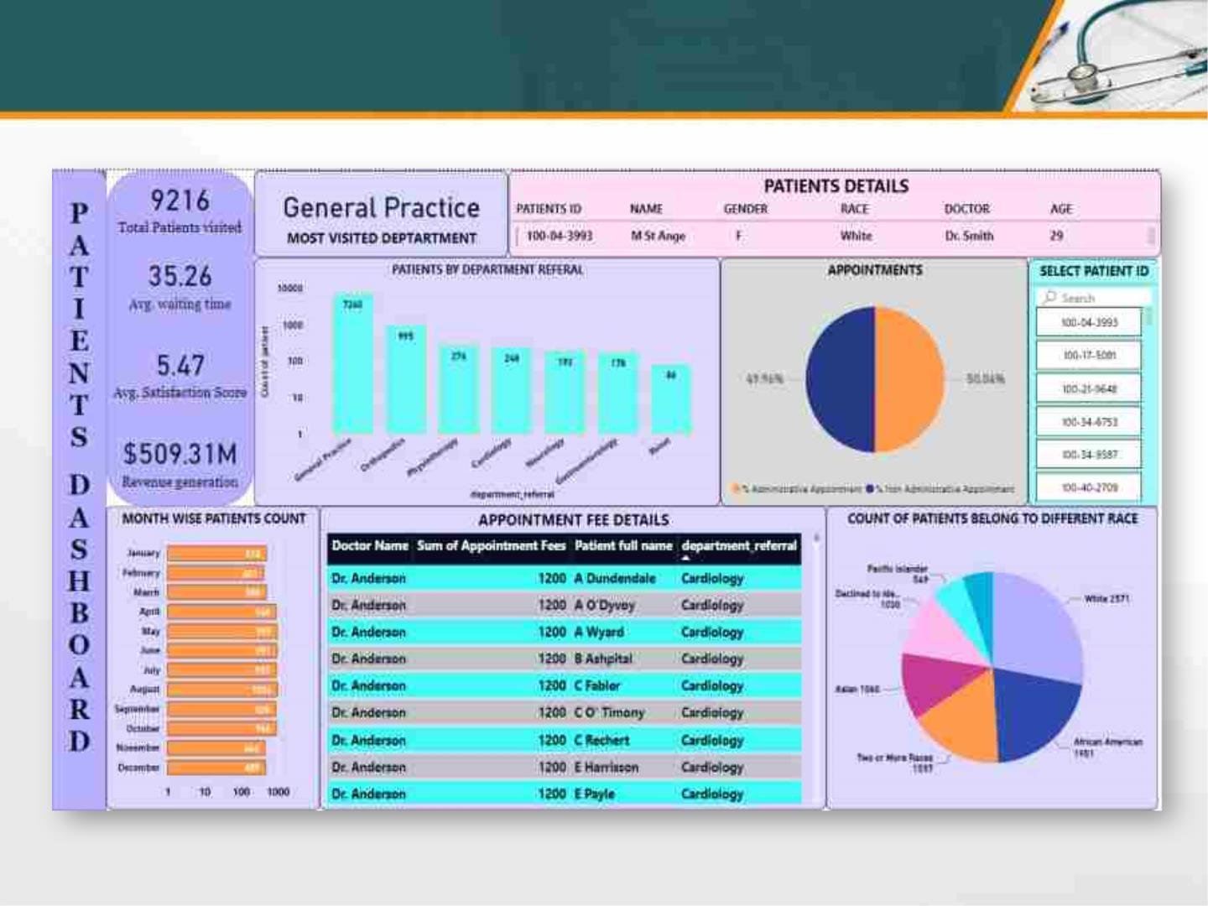
PATIENTS DASHBOARD

Slide 17

CONCLUSION
q The project report details the meticulous planning
and execution of a comprehensive hospital management
system at Columbia Asia Hospitals, renowned for their
emphasis on efficiency and affordability.
q It outlines the specific medical services offered,
catering to patients of all ages and ethnic backgrounds,
alongside the strategic project management approaches
ensuring timely completion and adherence to budget
constraints, ultimately serving as a roadmap for
establishing new Columbia Asia hospitals
committed to delivering quality healthcare at
accessible costs.

Slide 18
THANK YOU

